Slide 1
A Neural Network And Data Preparation Technique For Solving A General Unit-cell’s Tight-binding Equation

Slide 2
Disclaimer:
This initial network I designed before seeing the dataset we will be using. So it may need some further tweaks before it is relevant.
The dataset looks different from what I had imagined, so it may not be relevant at all, but may still be food for thought in terms of network structures.

Slide 3
Outline:
This method is a procedure to prepare all the relevant information of a unit-cell such that a neural network can more easily predict global properties of the crystal.
This could be generalised to models such as tight-binding or Hubbard, to predict groundstates
It assumes knowledge of just the unit-cell is sufficient to predict global properties

Slide 4
Aims:
Find a system to represent the unit cell in a way the neural network can more easily interpret.
The network should generalise to:
  Any number of atoms in the unit cell
  Any dimensional unit-cell 1D, 2D, 3D
  Translation and rotations of the unit-cell

Slide 5
Developing an embedding of unit-cell information
The neural network should predict the same properties independent of the following transformations:

Slide 6
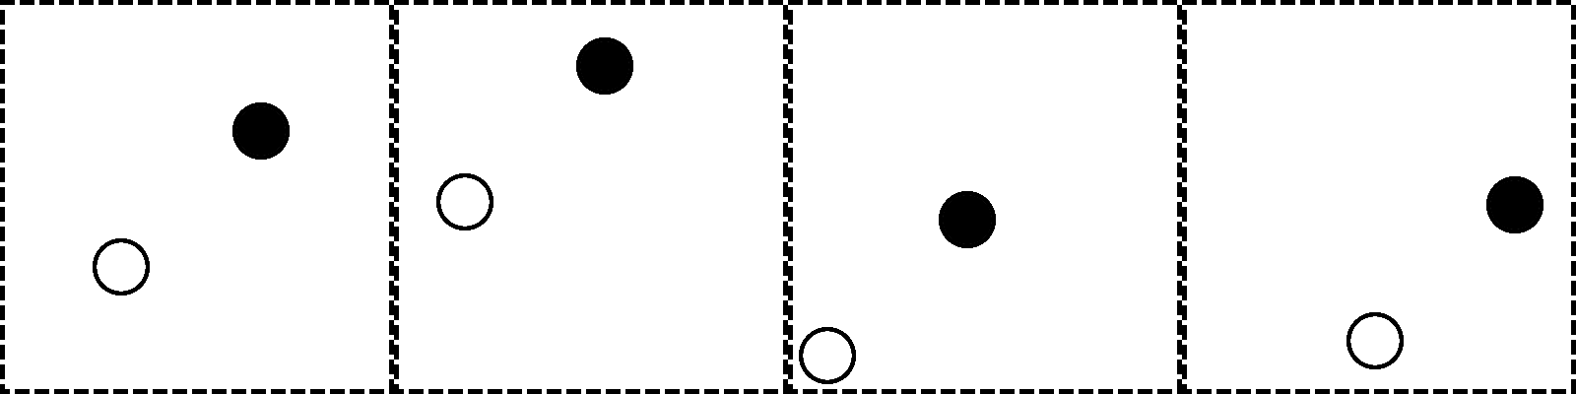
The network must be invariant to translation of unit cell

Slide 7
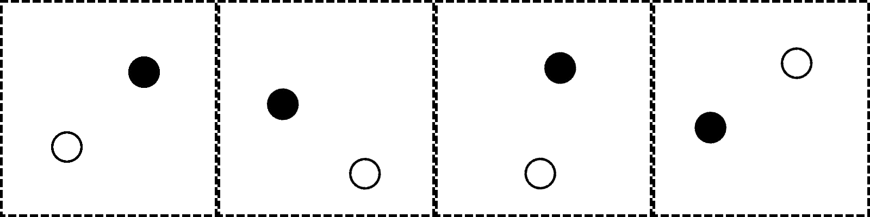
The network must be invariant to rotation of unit cell
(and all compositions of the two transformations - shown above)

Slide 8
Inferring only the pairwise relative distances need to be represented
Pros:
  Multi-dimensional scaling is lossless representation and a potentially good encoding schema
  Covers the invariance to unit-cell dimension
Cons:
  Difficult for the network to infer the angular relation of neighbours
  Poorly suited for nearest neighbour cutoffs when the unit cell is tesselated, as for it to be lossless all pairs need to be represented
  Only works for finite tessellations of unit cell
  Not invariant to number of atoms in unit cell

Slide 9
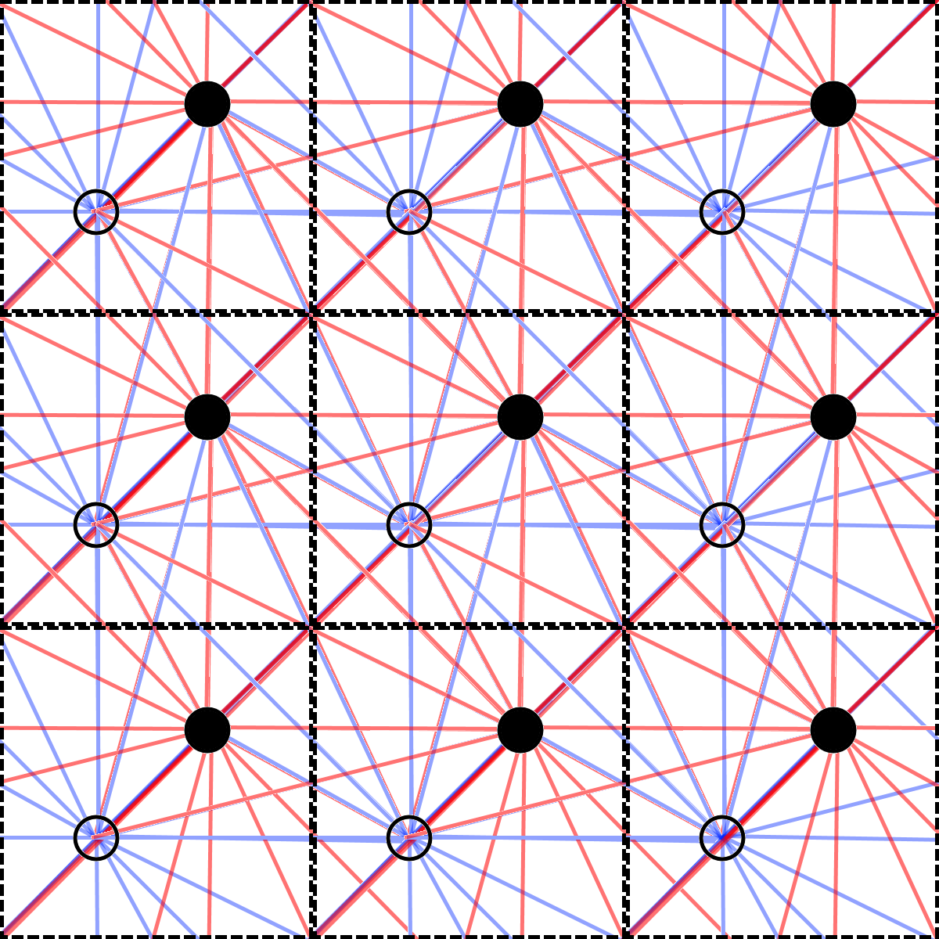
Pairwise Distances

Slide 10
Instead use pairwise (inverse magnitude) dot-product of atom displacements
Pros:
  Easy to truncate to nearest neighbours
  Captures relative distances (diagonals) and angular relations (off diagonal)
  Invariant to translation and rotation of unit-cell
  Invariant to dimension of the unit-cell
  Can capture non-local effect if truncation is applied past nearest neighbours
Cons:
  Not immediately invariant to number of atoms in basis
  Not invariant to permutation of order of pairwise dot-product

Slide 11
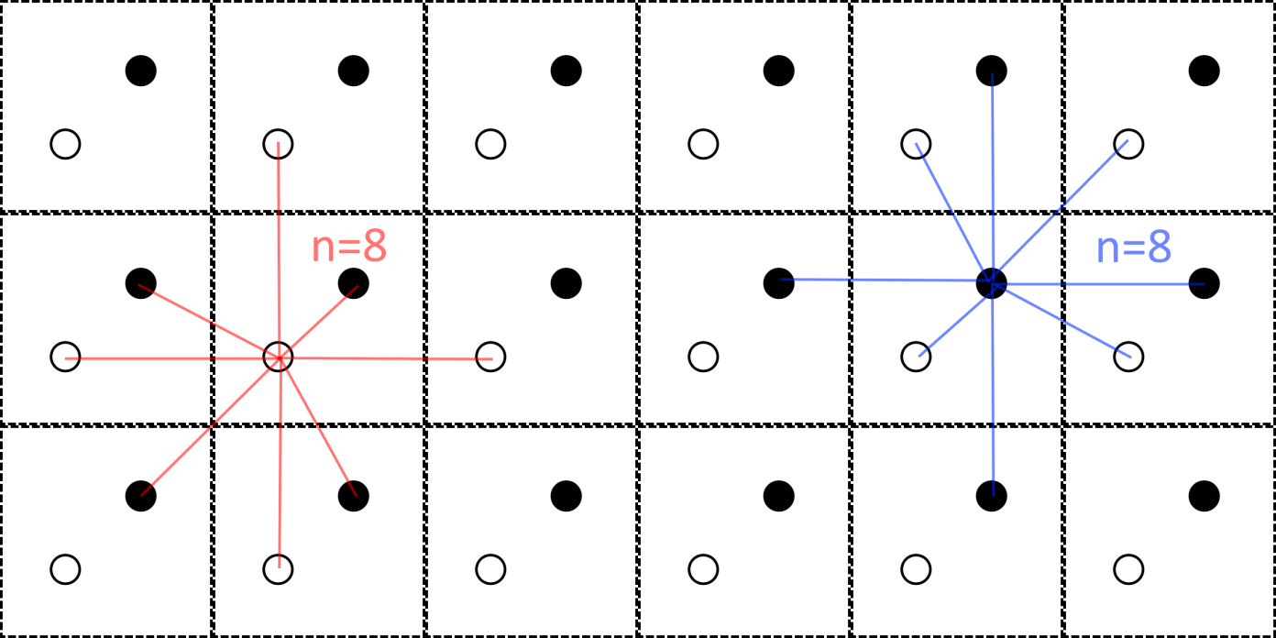
For n neighbours checked, and m atoms in unit cell, the pairwise dot product method generates a [m, n, n] (symmetric in last two dimensions) tensor.
Choose n large enough that effects become negligible.
Somehow need to add the type of atoms too (should be fairly easy)

Slide 12
This seems to be a sensible embedding
Generalises to any unit cell
Invariant to translation and rotation of unit-cell
Invariant to dimension of unit-cell
Would be effective at predicting hopping terms or ground states etc. In general global properties for an infinitely tessellated unit-cell should be predictable using this embedding.
Ineffective at predicting properties of a finitely tessellated unit-cell (hence might not be relevant for this project)

Slide 13
Making the network more generalised, invariant to these transformations, not only allows it to operate on all crystals, it also ensures needless data is not passed to the network
Otherwise the network may incorrectly overfit and become a function of these variables, compromising its extrapolation ability.
It is hoped that this embedding has minimal but sufficient degrees of freedom to well approximate the crystal properties.

Slide 14
Though the embedding is still not invariant to number of atoms in basis...

Slide 15
Requires a custom network architecture
Can use an attention-like mechanism commonly found in a transformer network. This makes the network invariant to number of atoms in the basis (m). (Can also use this technique for variable n)
By making a custom neural network for our task, we are no longer restricted by expressing the hamiltonian or crystal structure in a way compatible to computer vision problems.

Slide 16
Why attention mechanism?
Transformers work on NLP problems. These often consist of sentences with various numbers of words, so the network needs to be resilient to this. Attention mechanisms are designed for this issue.
Since the varying number of atoms in the unit-cell is analogous to the number of words in a sentence, then this means we can repurpose this mechanism.

Slide 17
One remaining issue:
The network should be invariant to permuting the ordering of which pairwise dot-products are calculated. There are at least three fixes:
  Make rules for consistently ordering the neighbours (though these would be arbitrary when considering neighbours at the same distance)
  Including all the permutations in the dataset to encourage the network to learn the desired invariance
  Can make a kernal which treats diagonal and off-diagonal elements separately and sum over in such a way that invariance is ensured (would need many kernals to not lose information)
First two are not ideal solutions.

Slide 18
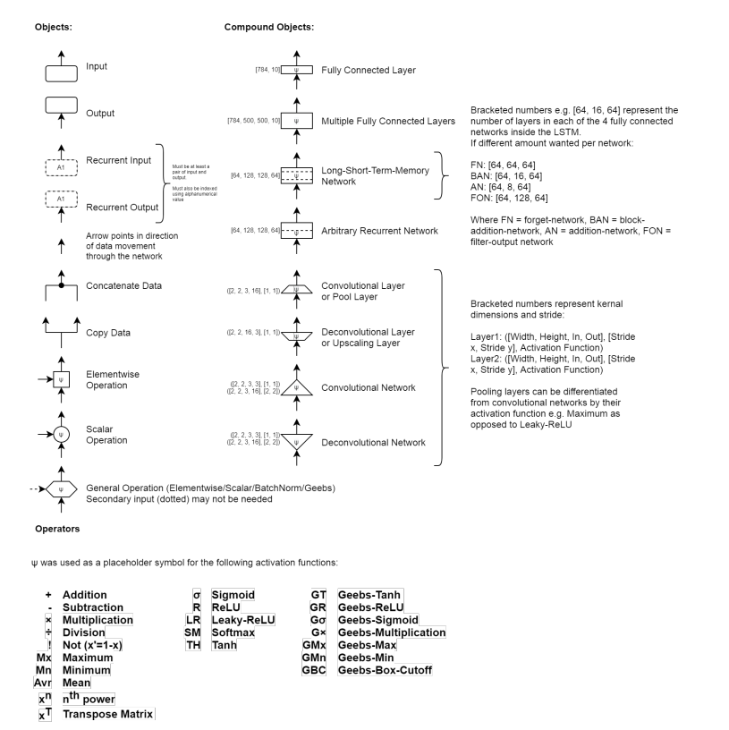
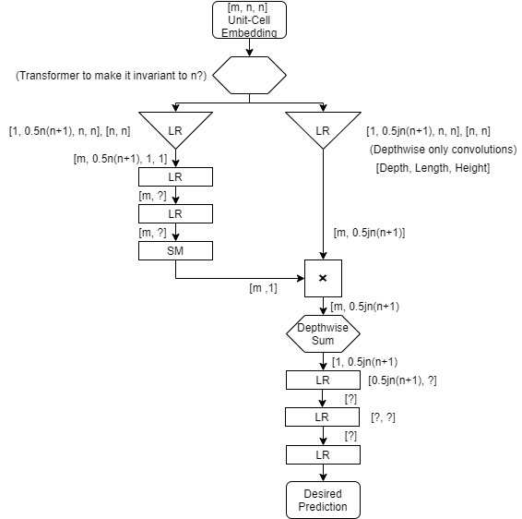
The network:

Slide 19
Overview
This network is generalised to any unit-cell! It can be trained on all experimentally tested unit-cells for a particular global property.
Using this information it should be able to produce predictions of properties of untested unit-cells hopefully accelerating development.
Dataset could be further expanded via p^{th} order perturbation theory.

Slide 20
Even more exciting...
Potential to back propagate to inputs (like deep-dream), this is theoretically possible (and more likely to work if the output ‘data manifold’ has equal intrinsic dimension to the input data manifold).
If trained sufficiently, this would allow you to specify desirable crystal properties and the network would ‘run in reverse’ to yield a unit-cell which would possess these desired properties.

Slide 21
Caveats
Though as mentioned, this was all developed prior to knowing the available dataset structure.
  So for the case of finite number of cells, the embedding technique is not well suited (the network should be though).
  Also since it treats the unit-cell as infinitely tessellated, it may struggle with edge effects. But if there are general edge-effects irrespective of crystal size then it should still work for these.
  It assumes the unit-cell provides sufficient information to predict these global properties.
Thus, it might not be the most applicable for the Hubbard model and BiTeI as these are specific cases as opposed to general cases. As well, edge effects are essential.

Slide 22
Specifically for BiTeI:
The cell offsets [i, j, k] form a 3D tensor e.g.[11, 9, 13], each element is itself a matrix [pi,pj] so [18, 18] and each term of these is a complex hopping, which itself is two real numbers. Resulting in 7D tensor [i, j, k, pi, pj, H_R, H_I]. A 4D kernal can be applied to last 4 dimensions and then convolved over first 3 dimensions, to form a 4D tensor, which can further convolved and flattened into a fully connected network.

Slide 23
Any questions?

